Slide 1

Data Sharding
Usman Razwan Haiqa Mushtaq Nabrass Gull Anas Inam

Slide 2

Scaling of Database

Slide 3
Scaling of Database
Roll No | Name | Age | Class | DoB | Address | Region | Domicile | CGPA | Blood | Gender | Session
1 | Ahmed | 18 | M2 | 11/11/2001 | Farid Town | Multan | Multan | 3.1 | A+ | Male | 2020-24
2 | Alisha | 19 | M2 | 01/01/2001 | Shadman | Sahiwal | Sahiwal | 3.4 | B+ | Female | 2020-24
3 | Babar | 27 | Captain | 15/10/1994 | PCB | Lahore | Lahore | Fail | O- | Male | 2019-23
4 | Noor | 20 | M2 | 10/12/2002 | Pak Avenue | Sahiwal | Sahiwal | 3.5 | AB+ | Female | 2020-24
5 | Umer | 20 | M2 | 11/11/2001 | Farid Town | Multan | Multan | 3.1 | A+ | Male | 2020-24
6 | Aftab | 19 | M2 | 01/01/2001 | Shadman | Sahiwal | Sahiwal | 3.4 | B+ | Female | 2020-24
7 | Usman | 27 | Captain | 15/10/1994 | PCB | Lahore | Lahore | Fail | O- | Male | 2019-23
8 | Noor | 20 | M2 | 10/12/2002 | Pak Avenue | Sahiwal | Sahiwal | 3.5 | AB+ | Female | 2020-24

Slide 4
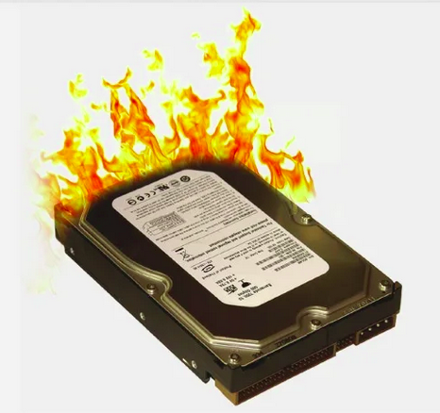
Scaling of Database
Drawbacks
Read/Write Throughput
Exceeds I/O

Slide 5
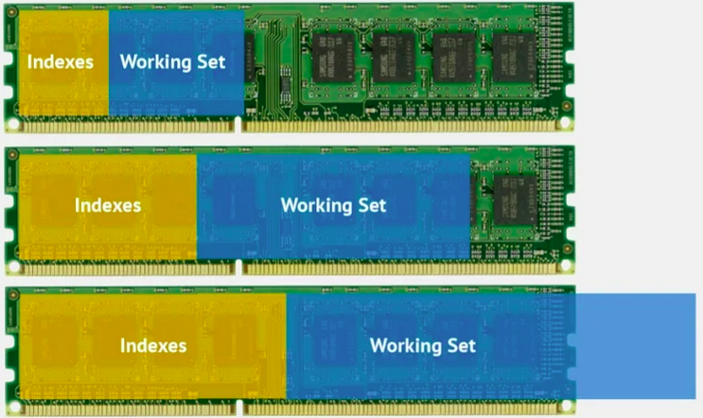
Scaling of Database
Drawbacks
RAM usage
increases

Slide 6
Scaling of Database
Drawbacks
High CPU usage
Database server runs out of storage
Network is overloaded
Increase in Response time
Chances of data loss

Slide 7
Database Sharding

Slide 8
Database Sharding
Roll No | Name | Age | Class
1 | Ahmed | 18 | M2
2 | Alisha | 19 | M2
3 | Babar | 27 | Captain
4 | Noor | 20 | M2
DoB | Address | Region | Domicile
11/11/2001 | Farid Town | Multan | Multan
01/01/2001 | Shadman | Sahiwal | Sahiwal
15/10/1994 | PCB | Lahore | Lahore
10/12/2002 | Pak Avenue | Sahiwal | Sahiwal
CGPA | Blood | Gender | Session
3.1 | A+ | Male | 2020-24
3.4 | B+ | Female | 2020-24
Fail | O- | Male | 2019-23
3.5 | AB+ | Female | 2020-24
Vertical Partitions

Slide 9
Database Sharding
Chunk
Shard
Roll No | Name | Age | Class
1 | Ahmed | 18 | M2
2 | Alisha | 19 | M2
3 | Babar | 27 | Captain
4 | Noor | 20 | M2
Roll No
1
2
3
4
DoB | Address | Region | Domicile
11/11/2001 | Farid Town | Multan | Multan
01/01/2001 | Shadman | Sahiwal | Sahiwal
15/10/1994 | PCB | Lahore | Lahore
10/12/2002 | Pak Avenue | Sahiwal | Sahiwal
Roll No
1
2
3
4
CGPA | Blood | Gender | Session
3.1 | A+ | Male | 2020-24
3.4 | B+ | Female | 2020-24
Fail | O- | Male | 2019-23
3.5 | AB+ | Female | 2020-24
Shared Key
Shared Key
Partition
Shared Key
Vertical Partitions

Slide 10
Database Sharding
Roll No | Name | Age | Class | DoB | Address | Region | Domicile | CGPA | Blood | Gender | Session
1 | Ahmed | 18 | M2 | 11/11/2001 | Farid Town | Multan | Multan | 3.1 | A+ | Male | 2020-24
2 | Alisha | 19 | M2 | 01/01/2001 | Shadman | Sahiwal | Sahiwal | 3.4 | B+ | Female | 2020-24
3 | Babar | 27 | Captain | 15/10/1994 | PCB | Lahore | Lahore | Fail | O- | Male | 2019-23
4 | Noor | 20 | M2 | 10/12/2002 | Pak Avenue | Sahiwal | Sahiwal | 3.5 | AB+ | Female | 2020-24
Horizontal Partitions

Slide 11
Range Based Sharding
Product | Price
Dairy Milk | 570
Ramen | 660
Water | 120
Coke | 150
Shampoo | 1200
Foot Ball | 1400
Product | Price
Dairy Milk | 570
Ramen | 660
Product | Price
Shampoo | 1200
Foot Ball | 1500
Product | Price
Water | 120
Coke | 150
0- 499
1000+
500-999

Slide 12
Data Sharding
Benefits of

Slide 13
Benefits of
Data Sharding
Increased Read/Write Throughput

Slide 14

Benefits of
Data Sharding
Increased Read/Write Throughput

Slide 15
Benefits of
Data Sharding
Increased storage Capacity

Slide 16
Benefits of
Data Sharding
Increased storage Capacity

Slide 17
Benefits of
Data Sharding
High Availability

Slide 18

Benefits of
Data Sharding
Product | Price
Dairy Milk | 570
Ramen | 660
Water | 120
Coke | 150
Shampoo | 1200
Foot Ball | 1400
High Availability

Slide 19
Benefits of
Data Sharding
Product | Price
Dairy Milk | 570
Ramen | 660
Water | 120
Coke | 150
Shampoo | 1200
Foot Ball | 1400
High Availability

Slide 20
Data Sharding
Drawbacks of

Slide 21
Drawbacks of
Data Sharding
Query Overhead

Slide 22
Drawbacks of
Data Sharding
Query Overhead
Product | Price
Dairy Milk | 570
Ramen | 660
0.5 Second
0.5 Second
Water | 120
Coke | 150
Index Computer
Shampoo | 1200
Foot Ball | 1400
0.5 Second
0.5 Second

Slide 23
Drawbacks of
Data Sharding
Complexity of Administration

Slide 24
Drawbacks of
Data Sharding
Complexity of Administration
Product | Price
Dairy Milk | 570
Ramen | 660
Water | 120
Coke | 150
Index Computer
Shampoo | 1200
Foot Ball | 1400

Slide 25
Drawbacks of
Data Sharding
Increased infrastrcutre costs

Slide 26
Drawbacks of
Data Sharding
Increased infrastrcutre costs
Product | Price
Dairy Milk | 570
Ramen | 660
Water | 120
Coke | 150
Index Computer
Shampoo | 1200
Foot Ball | 1400

Slide 27
Adoption

Slide 28
Adoption
Users in Millions
Users in Millions
Google
Facebook

Slide 29
Thank You

